Slide 1

IEEE International Conference on Acoustics, Speech, and Signal Processing
Multiview Depth Map Enhancement by
Variational Bayes Inference Estimation of Dirichlet Mixture Models
Pravin Kumar Rana, Zhanyu Ma, Jalil Taghia, and Markus Flierl
School of Electrical Engineering
KTH Royal Institute of Technology
Stockholm, Sweden
May 14, 2013

Slide 2
Background and motivation

Slide 3
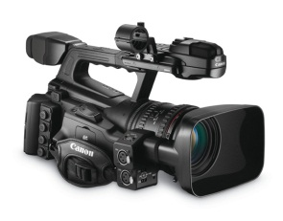
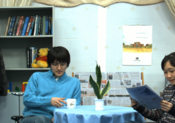
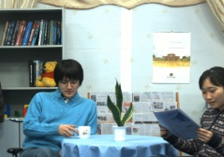
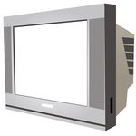

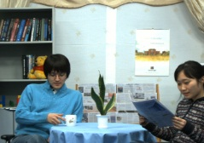
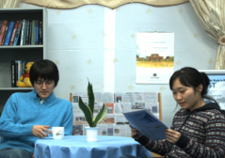
Free-viewpoint television
User | Display
Multiview video imagery
1

Slide 4
Free-viewpoint television
User | Display
Multiview video imagery
1

Slide 5
Free-viewpoint television
User | Display
Multiview video imagery
1

Slide 6
Free-viewpoint television
User | Display
Multiview video imagery
1

Slide 7
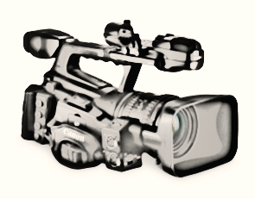
Free-viewpoint television
User | Display
Virtual camera | Virtual view
Multiview video imagery
1

Slide 8
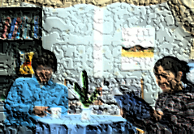
Depth image based rendering
Virtual camera | Virtual view
Multiview video imagery
2

Slide 9
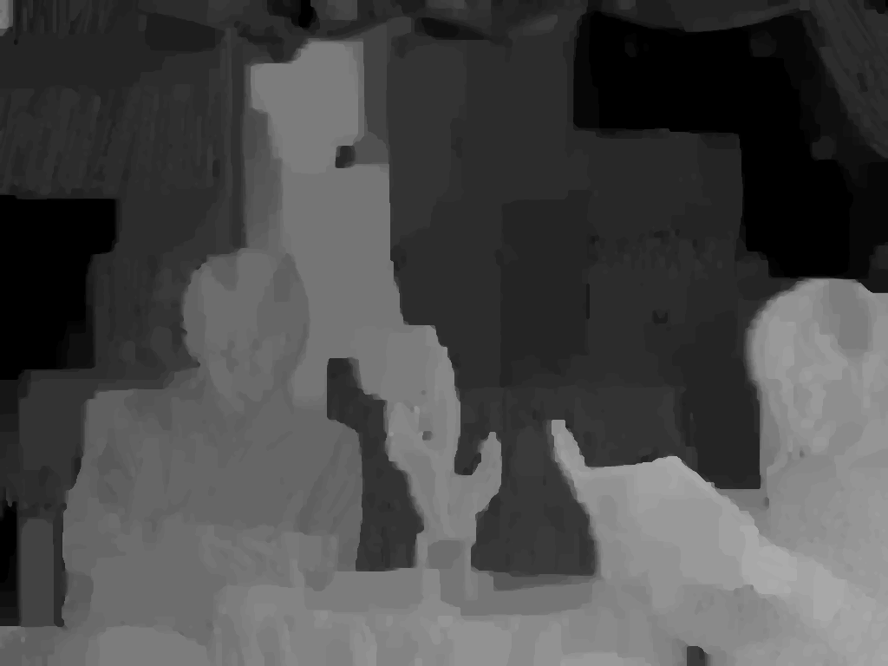
Depth image based rendering
Depth pixels represent shortest distance between object points and the camera plane
To be estimated from multiview imagery
Depth image
Near
Far
Virtual camera | Virtual view
Multiview video imagery
2

Slide 10

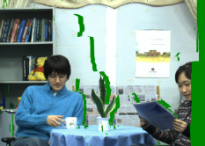

Depth image based rendering
Depth pixels represent shortest distance between object points and the camera plane
To be estimated from multiview imagery
Depth image
Near
3D warping
Far
?
Virtual camera | Virtual view
Multiview video imagery
2

Slide 11

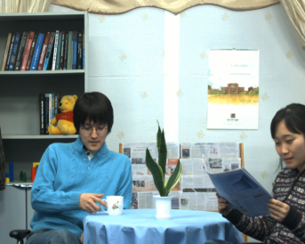

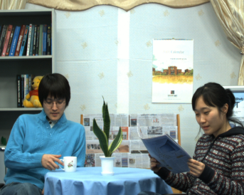
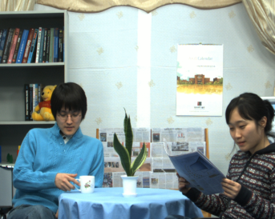

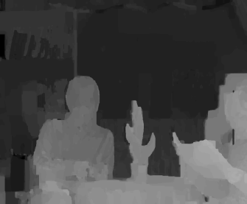
Depth estimation
MPEG Depth Estimation Reference Software
View (n-2) | View (n-1) | View (n) | View (n+1) | View (n+2) | View (n+3)
Depth estimation
 | View (n-1) | View 3
Note: we assume a 1D-parallel camera arrangement
3

Slide 12
Depth estimation
MPEG Depth Estimation Reference Software
View (n-2) | View (n-1) | View (n) | View (n+1) | View (n+2) | View (n+3)
Depth estimation
Depth estimation
Estimated depth maps
 | View (n-1) | View 3 | View 4 | View (n+2)
Note: we assume a 1D-parallel camera arrangement
3

Slide 13
Depth estimation
MPEG Depth Estimation Reference Software
View (n-2) | View (n-1) | View (n) | View (n+1) | View (n+2) | View (n+3)
Depth estimation
Depth estimation
Estimated depth maps
 | View (n-1) | View 3 | View 4 | View (n+2)
Problem: Inter-view depth inconsistency
Note: we assume a 1D-parallel camera arrangement
3

Slide 14
Improved depth enhancement framework

Slide 15
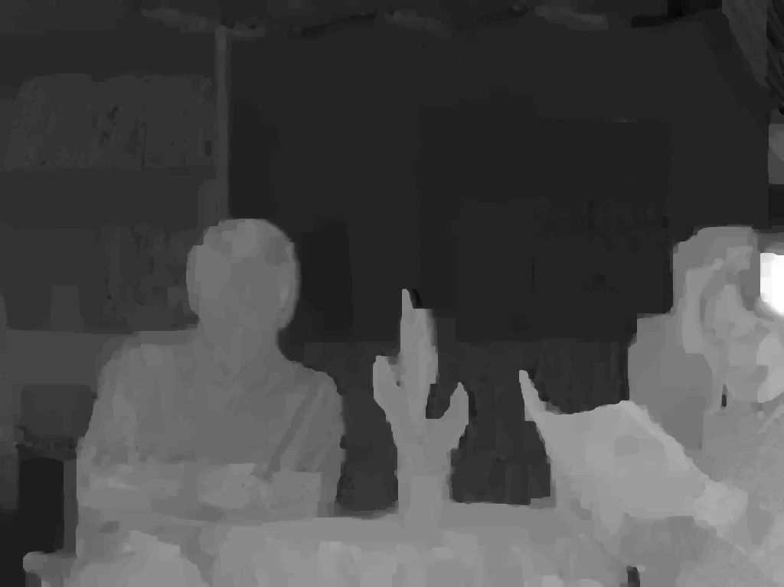
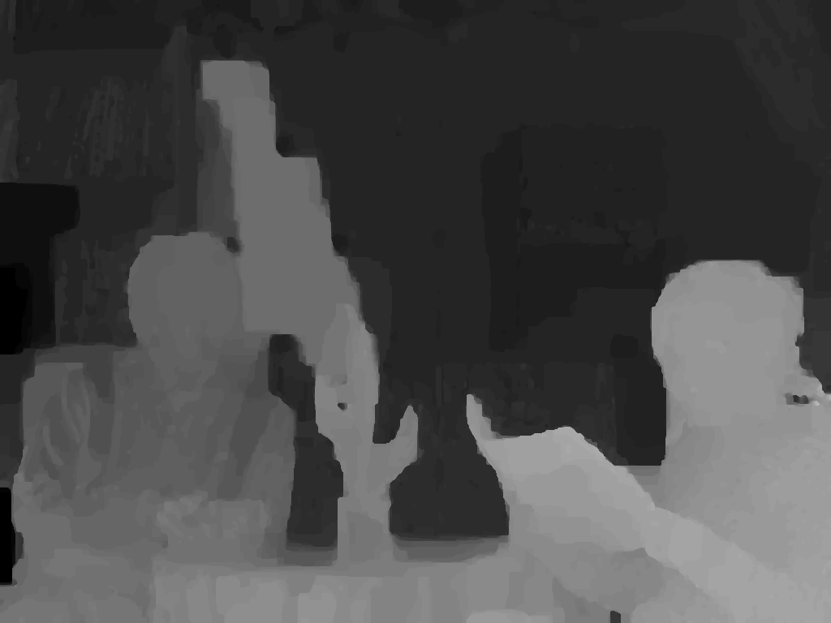
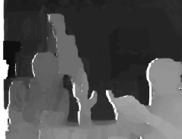
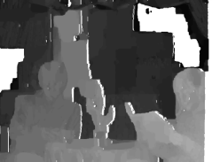
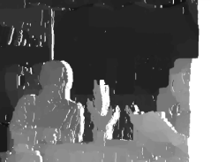
Prior work on depth enhancement
Existing methods warp depth images from multiple viewpoints to a common viewpoint for spatial alignment ([1], [2])
Warping errors due to the discrete values in depth maps affects enhancement algorithms negatively
Our approach ([3]):
Exploiting per-pixel associations between depth and color from various viewpoints
Use variational Bayes inference to classify color clusters in multiview imagery
View (1) |  | View (2) | View (n)
3D
warping
View (m)
Spatial alignment
[1] P. K. Rana and M. Flierl, “Depth consistency testing for improved view interpolation,” IEEE Int. Workshop MMSP, 2010.
[2] E. Ekmekcioglu, V. Velisavljevic, and S. Worrall, “Content adaptive enhancement of multi-view depth maps for free viewpoint video,” IEEE J. Sel. Topics Signal Process., 2011.
[3] P. K. Rana, J. Taghia, and M. Flierl, “A variational Bayesian inference framework for multiview depth image enhancement,” IEEE Int. Symp. Multimedia (ISM), 2012
4

Slide 16
Overview of depth enhancement framework
Concatenation of view imagery
Multiview color classification
Multiview depth classification
Depth image enhancement
5

Slide 17
Concatenation of view imagery
The captured MVV imagery of the scene has inherent inter-view similarity
To have a unique model for the captured natural scene,
The MVV inter-view similarity is exploited by concatenating views from multiple viewpoints
View (n-1) | View (n) | View (n+1) | View (n+2)
6

Slide 18
Concatenation of view imagery
The captured MVV imagery of the scene has inherent inter-view similarity
To have a unique model for the captured natural scene,
The MVV inter-view similarity is exploited by concatenating views from multiple viewpoints
View (n-1) | View (n) | View (n+1) | View (n+2)
View (n-1) | View (n) | View (n+1) | View (n+2)
6

Slide 19
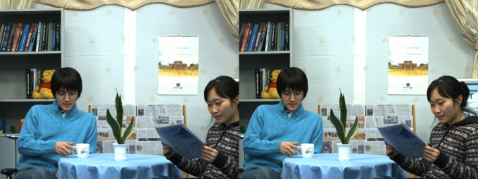
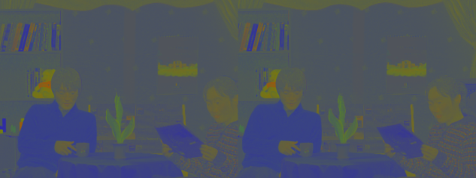
Multiview color classification
Use the chromatic color representation to make the procedure insensitive to the absolut luminance
The chromaticity of a pixel is described by a vector of three chromaticity coefﬁcients [x y z]^{T}
View (n) | View (n+1)
View (n) | View (n+1)
…
RGB xyz
…
…
…
x+y+z = 1
N views
N views
7

Slide 20
Multiview color classification
The goal of classification is to partition an image into regions each of which has a reasonably homogeneous visual appearance
Usually, classification algorithm, such as expectation-maximization for Gaussian mixtures, suffers from two main drawbacks:
model over-ﬁtting and
the number of clusters has to be known, (similar to the K-means algorithm)
With variational Bayes inference (VBI) [4] because
no model over-fitting,
the number of clusters is treated as a random variable
[4] C. M. Bishop, Pattern Recognition and Machine Learning, 1st ed. New York: Springer, 2006.
8

Slide 21
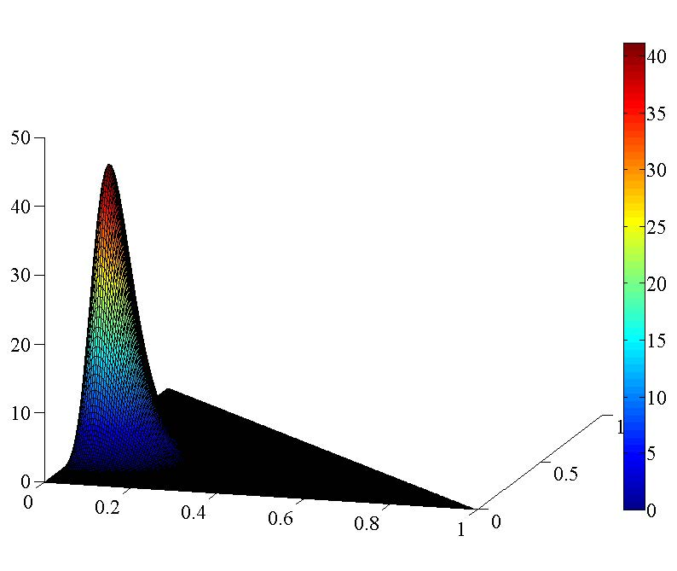
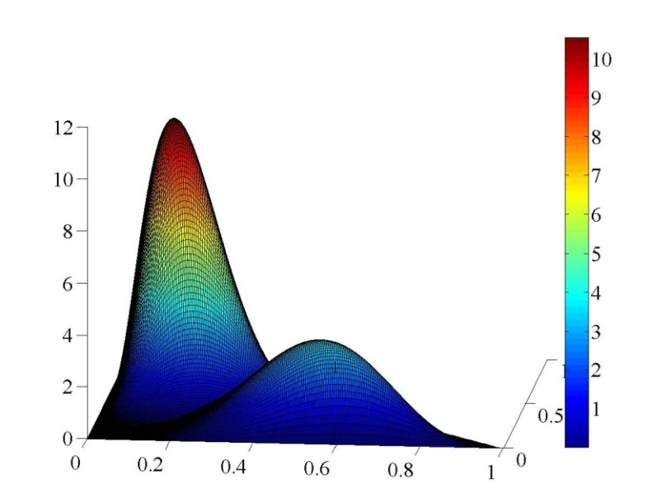
Multiview color classification
Dirichlet mixture model with variational Bayes inference (VBI)
The vector of image pixels has nonnegative elements and is bounded
it can be efﬁciently modeled by utilizing non-Gaussian distributions [5]
Based on the pixel vector’s properties,
assume that the pixel vectors of each cluster are Dirichlet distributed
Probability density function
of Dirichlet distribution
Probability density function
of Dirichlet mixture model
[4] C. M. Bishop, Pattern Recognition and Machine Learning, 1st ed. New York: Springer, 2006.
[5] Z. Ma, P. K. Rana, J. Taghia, M. Flierl, and A. Leijon, “Bayesian estimation of Dirichlet mixture model with variational inference,” IEEE Trans. PAMI, submitted, 2013.
9

Slide 22
Multiview color classification
Dirichlet mixture model with variational Bayes inference (VBI)
The vector of image pixels has nonnegative elements and is bounded
it can be efﬁciently modeled by utilizing non-Gaussian distributions [5]
Based on the pixel vector’s properties,
assume that the pixel vectors of each cluster are Dirichlet distributed
Use Dirichlet mixture model (DMM) with VBI to capture the all underlying clusters in multiview imagery [5]
It reduces the model complexity when compare to Gaussian mixture model with VBI
Probability density function
of Dirichlet distribution
Probability density function
of Dirichlet mixture model
[4] C. M. Bishop, Pattern Recognition and Machine Learning, 1st ed. New York: Springer, 2006.
[5] Z. Ma, P. K. Rana, J. Taghia, M. Flierl, and A. Leijon, “Bayesian estimation of Dirichlet mixture model with variational inference,” IEEE Trans. PAMI, submitted, 2013.
9

Slide 23

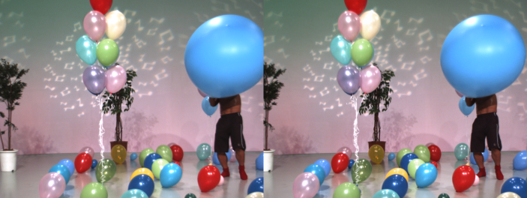
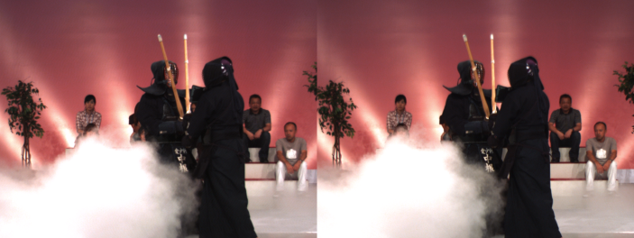
Multiview color classification
Newspaper Balloons Kendo
Input multiview data
10

Slide 24
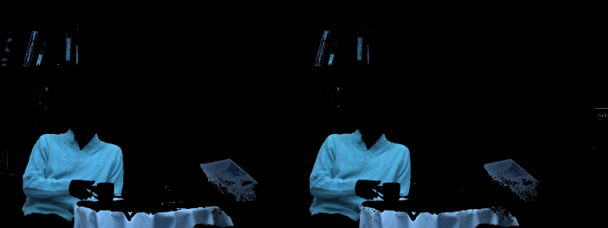
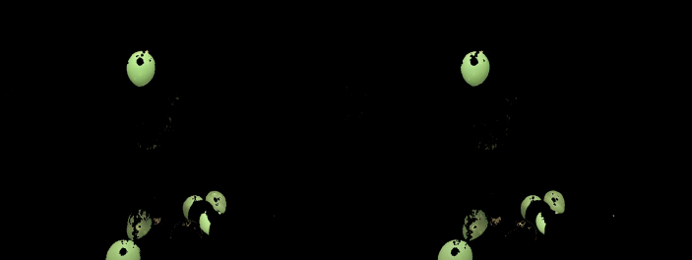
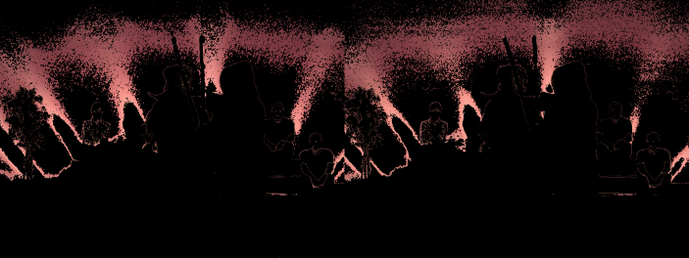
Multiview color classification
Newspaper Balloons Kendo
Input multiview data
Using Dirichlet mixture model with variational Bayes inference in xyz space
10

Slide 25

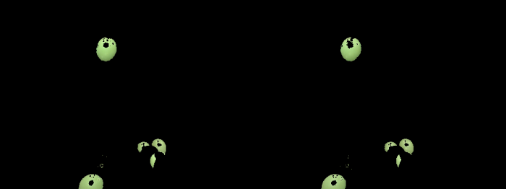
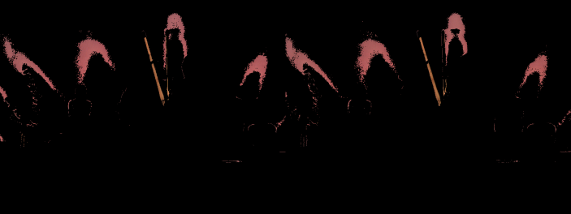
Multiview color classification
Newspaper Balloons Kendo
Input multiview data
Using Dirichlet mixture model with variational Bayes inference in xyz space
Using Gaussian mixture model with variational Bayes inference in RGB space
10

Slide 26
Multiview color classification
Newspaper Balloons Kendo
Input multiview data
Using Dirichlet mixture model with variational Bayes inference in xyz space
Using Gaussian mixture model with variational Bayes inference in RGB space
10

Slide 27
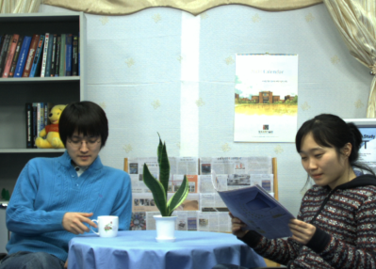

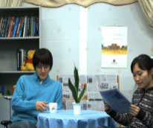
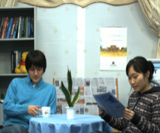
Multiview depth classification
Exploiting the per-pixel association between color and depth
View image | Depth image
Concatenated view imagery | Concatenated depth imagery
11

Slide 28
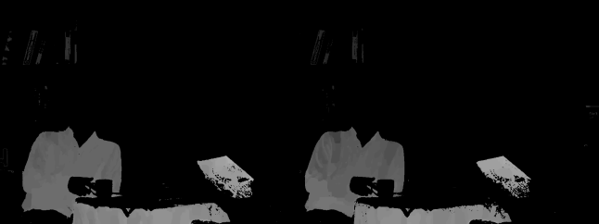
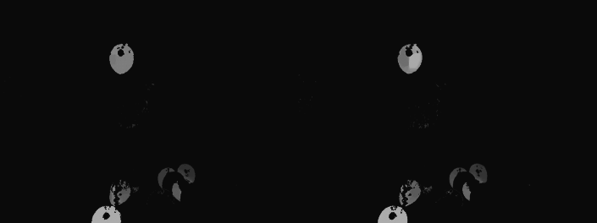
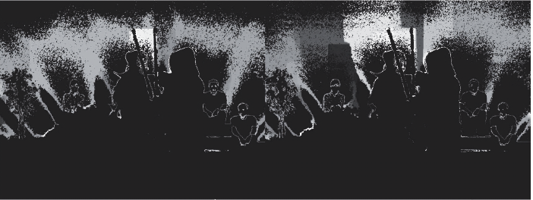
Multiview depth classification
Newspaper Balloons Kendo
Input multiview data
Using Dirichlet mixture model with variational Bayes inference in xyz space
12

Slide 29
Multiview depth enhancement
Difference between color and depth clusters
Members have similar colors pixels
Members may have different depth values
Why?
due to foreground and background depth difference
due to inter-view inconsistency
Our approach: Means-shift sub-clustering [5]
a nonparametric clustering technique
does not require prior knowledge of the number of clusters
does not constrain the shape of the clusters
assigns the mean to depth pixels irrespective of the originating viewpoints
Bayesian approaches imply higher computational complexity
[5] D. Comaniciu and P. Meer, “Mean shift: A robust approach toward feature space analysis,” IEEE Trans. Pattern Anal. Mach. Intell., 2002
13
Notes:
The members of a cluster are similar colors, whereas members of the corresponding depth cluster are different depth values.
Inter-view depth inconsistency : If an object point with a given color is visible from N viewpoints, this point should have the same depth value in all N depth maps.
However, such points usually have different depth values in the depth cluster due to the inconsistency across multiple viewpoints.

Slide 30
Experimental results

Slide 31

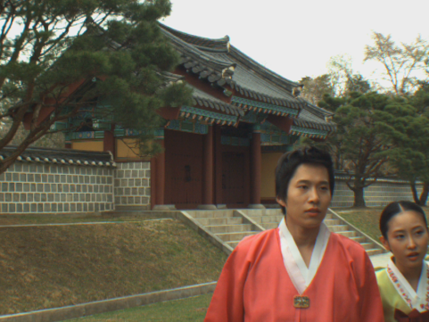
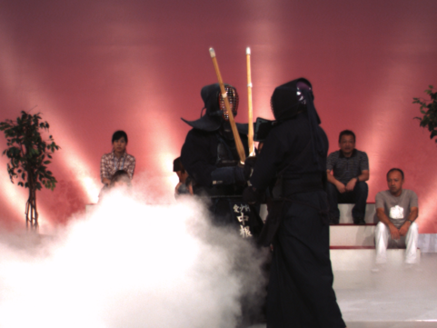
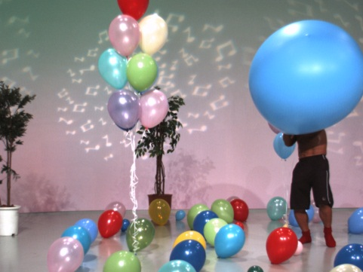
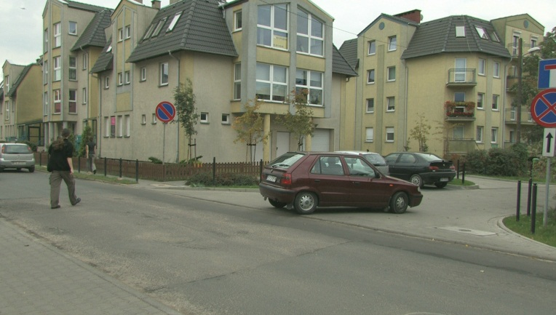
Experimental setup
MPEG 3DTV multiview data set
Newspaper
(1024 X 768)
Lovebird1
(1024 X 768)
Kendo
(1024 X 768)
Balloons
(1024 X 768)
Poznan street
(1920 X 1088)
14

Slide 32
Model complexity
By measuring the model complexity in terms of the number of free parameters:
VBI-DMM requires a smaller model complexity than the VBI-GMM
Input Vector | Initial number of mixture components | Number of free parameters
 |  | VBI-GMM | VBI-DMM
D | I | I(2D + 1) −1 | I(D + 2) −1
In experiment,
Initial number of mixture components = 100
Multiview Data Set | Active number of mixture components
 | VBI-GMM | VBI-DMM
Lovebird1 | 31 | 24
Kendo | 34 | 15
15

Slide 33
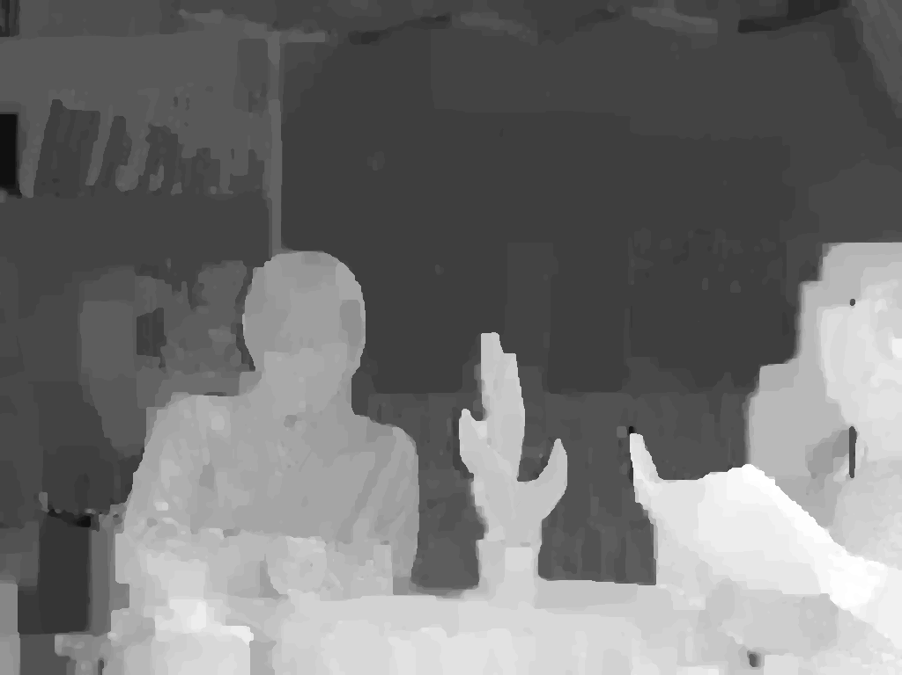
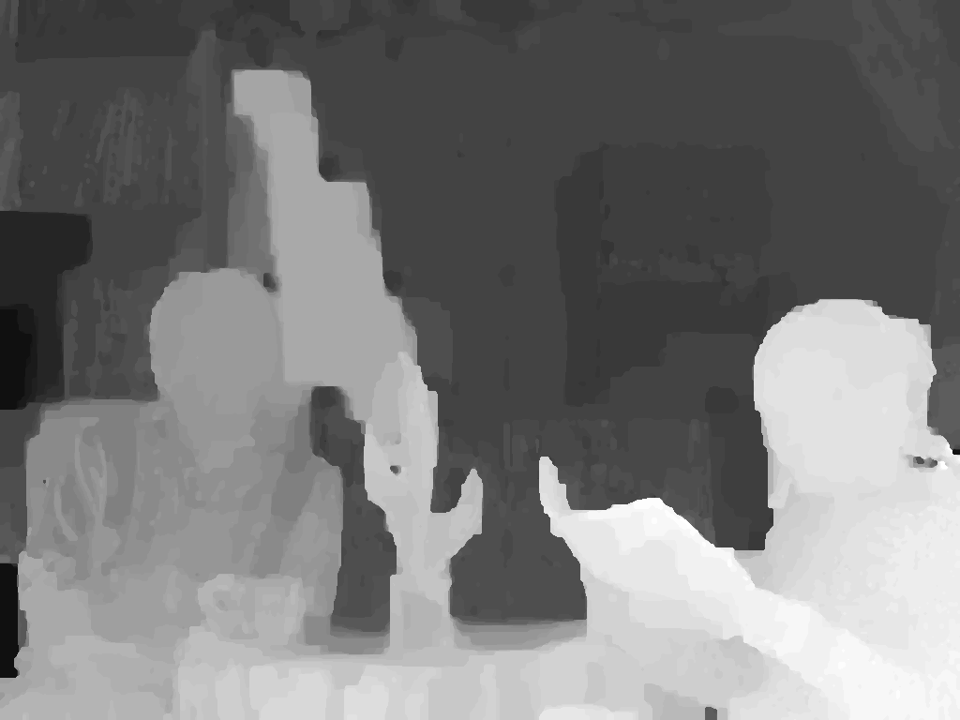
Depth image based rendering
MPEG View Synthesis Reference Software (VSRS) 3.5
Enhanced depth map
Left
Enhanced depth map
Right
16

Slide 34
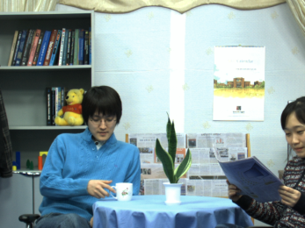

Depth image based rendering
MPEG View Synthesis Reference Software (VSRS) 3.5
Enhanced depth map
Left
Reference view
Enhanced depth map
Right
Reference view
16

Slide 35

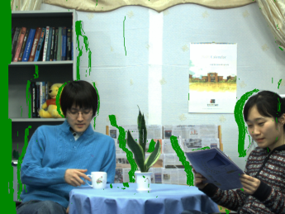
Depth image based rendering
MPEG View Synthesis Reference Software (VSRS) 3.5
Enhanced depth map
Warped view
3D warping
Left
Reference view
Enhanced depth map
3D warping
Right
Warped view
Reference view
16

Slide 36
Depth image based rendering
MPEG View Synthesis Reference Software (VSRS) 3.5
Enhanced depth map
Warped view
3D warping
Left
Reference view
Hole filling & inpainting
Enhanced depth map
3D warping
Right
Warped view
Reference view
16

Slide 37
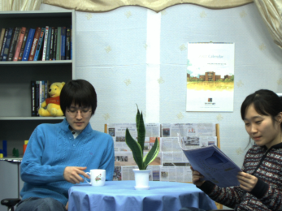
Depth image based rendering
MPEG View Synthesis Reference Software (VSRS) 3.5
Enhanced depth map
Warped view
3D warping
Left
Reference view
Hole filling & inpainting
Enhanced depth map
Virtual intermediate view
3D warping
Right
Warped view
Reference view
16

Slide 38

Depth image based rendering
MPEG View Synthesis Reference Software (VSRS) 3.5
Enhanced depth map
Warped view
3D warping
Left
Reference view
Hole filling & inpainting
Enhanced depth map
Virtual intermediate view
3D warping
Right
Warped view
Reference view
Original camera view
16

Slide 39
Depth image based rendering
MPEG View Synthesis Reference Software (VSRS) 3.5
Enhanced depth map
Warped view
3D warping
Left
Y-PSNR (dB)
Reference view
Hole filling & inpainting
Enhanced depth map
Virtual intermediate view
3D warping
Right
Warped view
Reference view
Original camera view
16

Slide 40
Objective results
Test sequence | Input views | Virtual view | MPEG VSRS 3.5 [dB]
 |  |  | MPEG depth maps | VBGMM K-Means depth maps | VBDMM Mean-shift depth maps
Newspaper | 4,6 | 5 | 32.00 | 32.10 | 32.11
Kendo | 3,5 | 5 | 36.54 | 36.72 | 39.35
Poznan Street | 3,5 | 4 | 35.56 | 35.58 | 35.72
Lovebird1 | 6,8 | 7 | 28.50 | 28.68 | 29.04
Balloons | 3,5 | 4 | 35.69 | 35.93 | 36.02
Color classification
Initial number of color clusters: 50
K-means sub-clustering
Number of cluster : 12
17

Slide 41
Objective results
Test sequence | Input views | Virtual view | MPEG VSRS 3.5 [dB]
 |  |  | MPEG depth maps | VBGMM K-Means depth maps | VBDMM Mean-shift depth maps
Newspaper | 4,6 | 5 | 32.00 | 32.10 | 32.11
Kendo | 3,5 | 5 | 36.54 | 36.72 | 39.35
Poznan Street | 3,5 | 4 | 35.56 | 35.58 | 35.72
Lovebird1 | 6,8 | 7 | 28.50 | 28.68 | 29.04
Balloons | 3,5 | 4 | 35.69 | 35.93 | 36.02
Color classification
Initial number of color clusters: 50
K-means sub-clustering
Number of cluster : 12
17

Slide 42
Objective results
Test sequence | Input views | Virtual view | MPEG VSRS 3.5 [dB]
 |  |  | MPEG depth maps | VBGMM K-Means depth maps | VBDMM Mean-shift depth maps
Newspaper | 4,6 | 5 | 32.00 | 32.10 | 32.11
Kendo | 3,5 | 5 | 36.54 | 36.72 | 39.35
Poznan Street | 3,5 | 4 | 35.56 | 35.58 | 35.72
Lovebird1 | 6,8 | 7 | 28.50 | 28.68 | 29.04
Balloons | 3,5 | 4 | 35.69 | 35.93 | 36.02
Color classification
Initial number of color clusters: 50
K-means sub-clustering
Number of cluster : 12
17

Slide 43
Objective results
Test sequence | Input views | Virtual view | MPEG VSRS 3.5 [dB]
 |  |  | MPEG depth maps | VBGMM K-Means depth maps | VBDMM Mean-shift depth maps
Newspaper | 4,6 | 5 | 32.00 | 32.10 | 32.11
Kendo | 3,5 | 5 | 36.54 | 36.72 | 39.35
Poznan Street | 3,5 | 4 | 35.56 | 35.58 | 35.72
Lovebird1 | 6,8 | 7 | 28.50 | 28.68 | 29.04
Balloons | 3,5 | 4 | 35.69 | 35.93 | 36.02
Color classification
Initial number of color clusters: 50
K-means sub-clustering
Number of cluster : 12
17

Slide 44
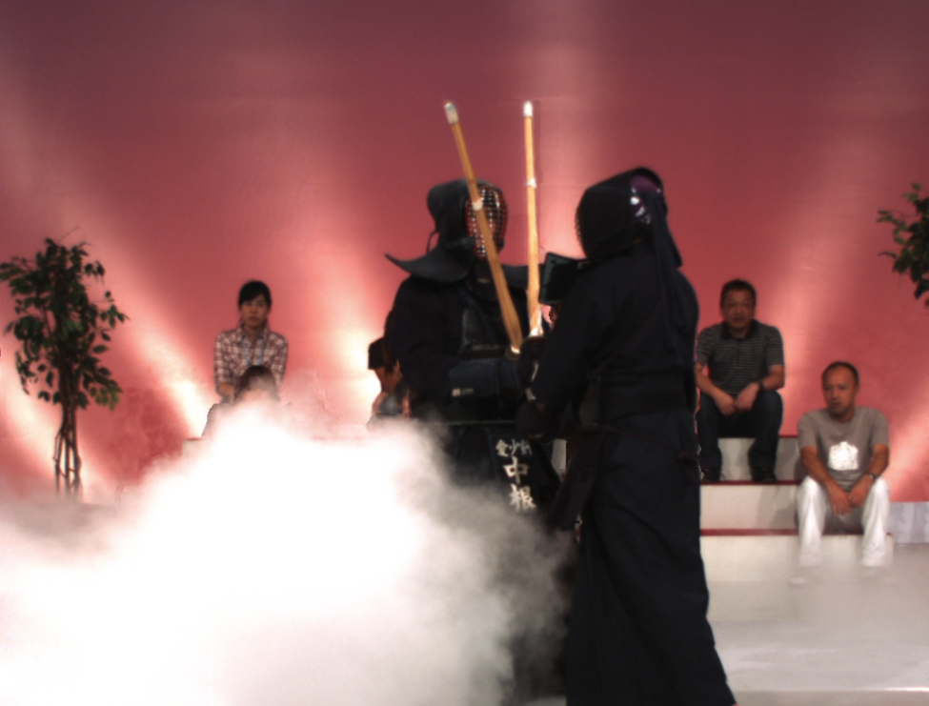
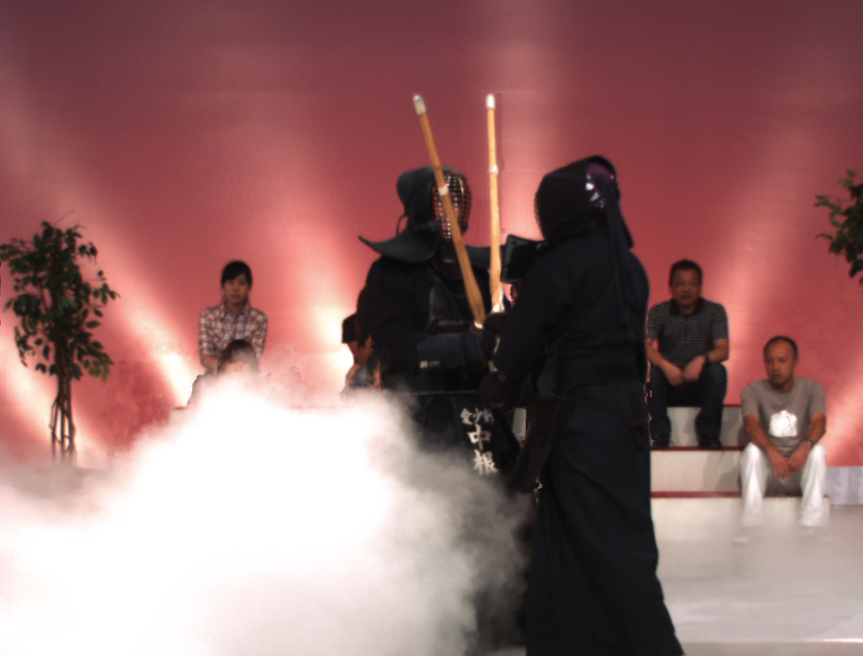
Subjective results
Test sequence: Kendo
With MPEG depth map
With VBDMM Mean-shift depth map
18

Slide 45
Subjective results
Test sequence: Kendo
With MPEG depth map
With VBDMM Mean-shift depth map
18

Slide 46
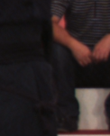
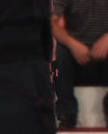


Subjective results
Test sequence: Kendo
Original
depth maps
With MPEG depth maps
With VBGMM K-Means
depth maps
With VBDMM Mean-Shift
depth maps
18

Slide 47
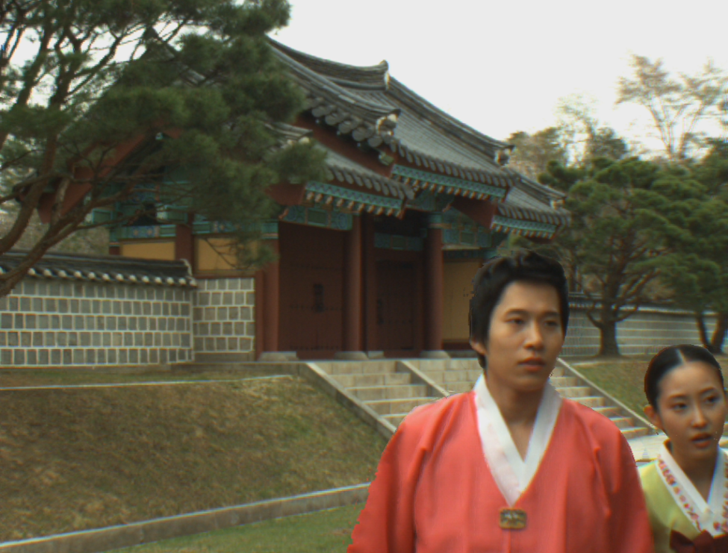

Subjective results
Test sequence: Lovebird 1
With MPEG depth map
With VBDMM Mean-shift depth map
19

Slide 48
Subjective results
Test sequence: Lovebird 1
With MPEG depth map
With VBDMM Mean-shift depth map
19

Slide 49




Subjective results
Test sequence: Lovebird 1
Original
depth maps
With MPEG depth maps
With VBGMM K-Means
depth maps
With VBDMM Mean-Shift
depth maps
19

Slide 50
Subjective results
Test sequence: Lovebird 1
With MPEG depth map
With VBDMM Mean-shift depth map
19

Slide 51




Subjective results
Test sequence: Lovebird 1
Original
depth maps
With MPEG depth maps
With VBGMM K-Means
depth maps
With VBDMM Mean-Shift
depth maps
19

Slide 52


Subjective results
Test sequence: Newspaper
With MPEG depth map
With VBDMM Mean-shift depth map
20

Slide 53
Subjective results
Test sequence: Newspaper
With MPEG depth map
With VBDMM Mean-shift depth map
20

Slide 54




Subjective results
Sequence: Newspaper
Original
depth maps
With MPEG depth maps
With VBGMM K-Means
depth maps
With VBDMM Mean-Shift
depth maps
20

Slide 55
Subjective results
Test sequence: Newspaper
With MPEG depth map
With VBDMM Mean-shift depth map
20

Slide 56




Subjective results
Sequence: Newspaper
Original
depth maps
With MPEG depth maps
With VBGMM K-Means
depth maps
With VBDMM Mean-Shift
depth maps
20

Slide 57


Subjective results
Sequence: Balloons
With MPEG depth map
With VBDMM Mean-shift depth map
21

Slide 58
Subjective results
Sequence: Balloons
With MPEG depth map
With VBDMM Mean-shift depth map
21

Slide 59




Subjective results
Sequence: Balloons
Original
depth maps
With MPEG depth maps
With VBGMM K-Means
depth maps
With VBDMM Mean-Shift
depth maps
21

Slide 60


Subjective results
Sequence: Poznan Street
With MPEG depth map
With VBDMM Mean-shift depth map
22

Slide 61
Subjective results
Sequence: Poznan Street
With MPEG depth map
With VBDMM Mean-shift depth map
22

Slide 62




Subjective results
Sequence: Poznan Street
Original
depth maps
With MPEG depth maps
With VBGMM K-Means
depth maps
With VBDMM Mean-Shift
depth maps
22

Slide 63
Subjective results
Sequence: Poznan Street
With MPEG depth map
With VBDMM Mean-shift depth map
22

Slide 64




Subjective results
Sequence: Poznan Street
Original
depth maps
With MPEG depth maps
With VBGMM K-Means
depth maps
With VBDMM Mean-Shift
depth maps
22

Slide 65
Conclusions
We improved the inter-view depth consistency and hence, enhanced the visual experience of free-viewpoint television
For that, we exploited the per-pixel association between depth and color by classification
Color classification in xyz space is accomplished by variational Bayesian inference. Then, color classes are used for depth classification
Depth sub-clustering with Mean-shift improves the depth maps and hence view rendering quality
Effectiveness of our approach is demonstrated by both objective and subjective results
23

Slide 66
Thank you

Slide 67
Multiview color classification
Dirichlet mixture model with variational Bayes inference
Repeat
Until convergence
xyz
data
Initialization
Optimization of the variational posterior distribution
Variational lower bound evaluation
Color
clusters
[4] C. M. Bishop, Pattern Recognition and Machine Learning, 1st ed. New York: Springer, 2006.
[5] Z. Ma, P. K. Rana, J. Taghia, M. Flierl, and A. Leijon, “Bayesian estimation of Dirichlet mixture model with variational inference,” IEEE Trans. PAMI, submitted, 2013.
X

Slide 68
Multiview color classification
Dirichlet mixture model with variational Bayes inference
Repeat
Until convergence
xyz
data
Initialization
Optimization of the variational posterior distribution
Variational lower bound evaluation
Color
clusters
Initialize number of clusters
Initialize hyper-parameters
Initialize responsibilities
[4] C. M. Bishop, Pattern Recognition and Machine Learning, 1st ed. New York: Springer, 2006.
[5] Z. Ma, P. K. Rana, J. Taghia, M. Flierl, and A. Leijon, “Bayesian estimation of Dirichlet mixture model with variational inference,” IEEE Trans. PAMI, submitted, 2013.
X

Slide 69
Multiview color classification
Dirichlet mixture model with variational Bayes inference
Repeat
Until convergence
xyz
data
Initialization
Optimization of the variational posterior distribution
Variational lower bound evaluation
Color
clusters
Maximize the variational lower bound on free energy
Evaluate the responsibilities
Update the hyper-parameters
[4] C. M. Bishop, Pattern Recognition and Machine Learning, 1st ed. New York: Springer, 2006.
[5] Z. Ma, P. K. Rana, J. Taghia, M. Flierl, and A. Leijon, “Bayesian estimation of Dirichlet mixture model with variational inference,” IEEE Trans. PAMI, submitted, 2013.
X

Slide 70
Multiview color classification
Dirichlet mixture model with variational Bayes inference
Repeat
Until convergence
xyz
data
Initialization
Optimization of the variational posterior distribution
Variational lower bound evaluation
Color
clusters
Check for convergence
[4] C. M. Bishop, Pattern Recognition and Machine Learning, 1st ed. New York: Springer, 2006.
[5] Z. Ma, P. K. Rana, J. Taghia, M. Flierl, and A. Leijon, “Bayesian estimation of Dirichlet mixture model with variational inference,” IEEE Trans. PAMI, submitted, 2013.
X

Slide 71
Multiview color classification
Dirichlet mixture model with variational Bayes inference
Repeat
Until convergence
xyz
data
Initialization
Optimization of the variational posterior distribution
Variational lower bound evaluation
Color
clusters
[4] C. M. Bishop, Pattern Recognition and Machine Learning, 1st ed. New York: Springer, 2006.
[5] Z. Ma, P. K. Rana, J. Taghia, M. Flierl, and A. Leijon, “Bayesian estimation of Dirichlet mixture model with variational inference,” IEEE Trans. PAMI, submitted, 2013.
X

Slide 72
Multiview color classification
Dirichlet mixture model with variational Bayes inference
Repeat
Until convergence
xyz
data
Initialization
Optimization of the variational posterior distribution
Variational lower bound evaluation
Color
clusters
[4] C. M. Bishop, Pattern Recognition and Machine Learning, 1st ed. New York: Springer, 2006.
[5] Z. Ma, P. K. Rana, J. Taghia, M. Flierl, and A. Leijon, “Bayesian estimation of Dirichlet mixture model with variational inference,” IEEE Trans. PAMI, submitted, 2013.
X

Slide 73
Future directions
Improve color classification performance
Improve computational efficiency of color classification
Improve depth sub-clustering
Improve temporal depth consistency
Y

Slide 74

Dirichlet plot details
For probability density function of Dirichlet distribution $α=[2 10 15]$
For probability density function of Dirichlet mixture model parameters ${ α}_{1}=\left[6 2 4\right]$ and $α_{2}=[3 8 5]$ with mixture weights $π_{1}=0.3$ and $π_{2}=0.7$, respectively.
Z

